Slide 1
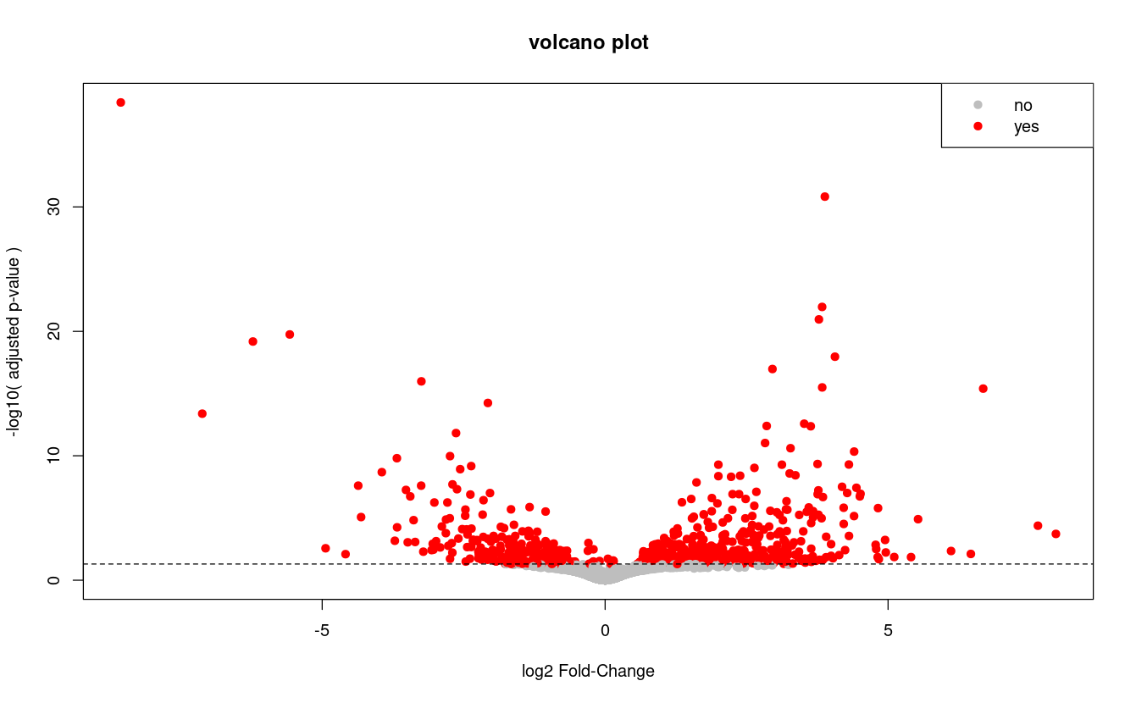

Let's practice – extra – 1/2
In this extra practice session we are going to read in a csv file that contain the result of a Differential Gene Expression analysis from RNAseq data.
Briefly, this dataset consists in a table where each line is a gene and the different columns contains information about the change in expression level between two experimental conditions.
The most important columns here are:
padj : contains the adjusted p-value (a low p-value denotes a gene whose expression is significatively different between the conditions)
log2FoldChange : logarithm2 of the fold-change between the two conditions (eg, a value of 1 mean that the expressed twice a much ; -1 means that the gene is expressed half as much)
Our goal is to quickly analyse this data and ultimately generate
a volcano plot, which should look somewhat like this:
The Instructions are in the next slide.
Reminder: You can find a solution script in the solutions/ folder

Slide 2
Let's practice – extra – 2/2
read the csv file course_datasets/Ruhland2016.DESeq2.results.csv as a data.frame, using the first row as row names.
Create a new column named "significant" which contains the text "yes" if the adjusted p-value (column padj) is below the significance threshold 0.05, and "no" otherwise.
how many genes have a significant adjusted p-value?
What is the average of the absolute value of log-fold change? (nb: you may have to google the function to compute the absolute value)
For all genes?
For significant genes only?
creating a volcano plot
Create a new column containing -log10( adjusted p-value ) (it will be used for the y-axis)
basic plot: plot the log-fold change (x-axis) with -log10( adjusted p-value ) (y-axis)
adding colors: adapt the previous plot to change the pch to 19, and color in grey non-significant genes and in reed significant ones (you can use the "significant" column we created earlier)
adding threshold line: add an horizontal dashed black line to visualize the 0.05 threshold on adjusted p-value
beautify: add a title, axis labels, and legend

